Slide 1
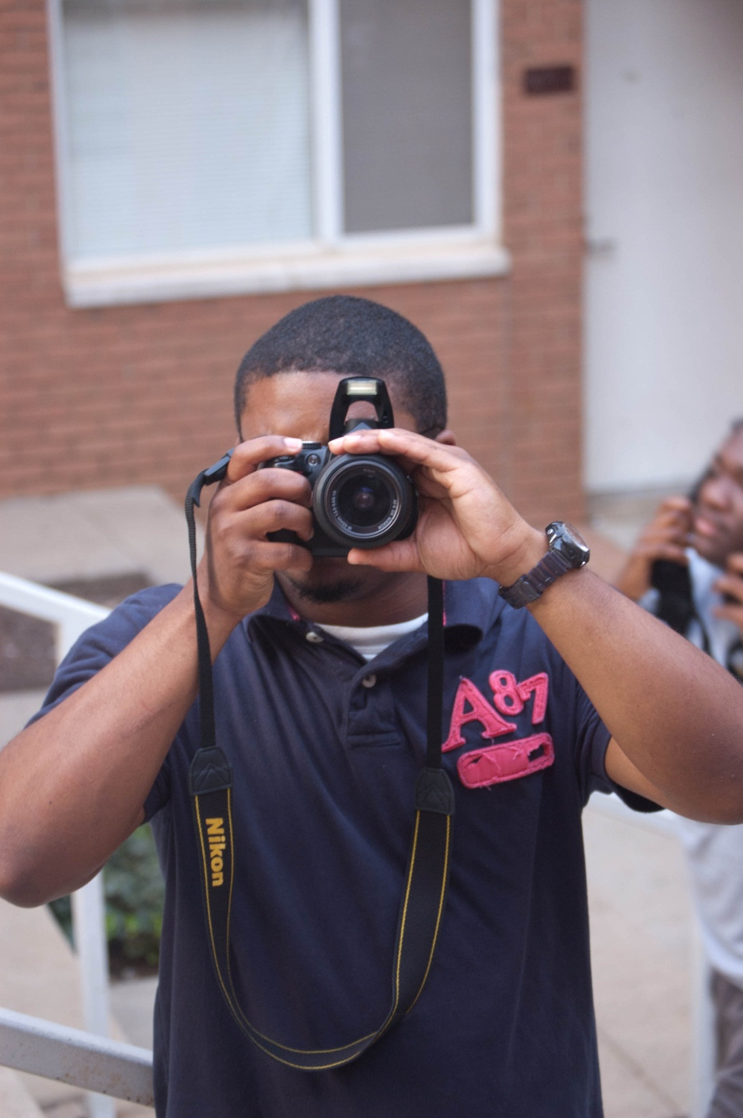
Are You COLLEGE READY?
5-6.2 Use print sources (for example, books, magazines, charts, graphs, diagrams, dictionaries, encyclopedias, atlases, thesauri, newspapers, and almanacs) and nonprint sources to access information.
5-6.3 Select information appropriate for the research topic.
5-6.4 Paraphrase research information accurately and meaningfully.

Slide 2
Getting Prepared Now!
Find important information
Find something you like about the school
Brainstorm about why you would like to attend this college or university.
Write a letter to the President of that particular university expressing your thoughts about the school.
Hint: Use the extended response writing rubric as your guide.

Slide 3
October 28, 2011
Dear President Henry Tisdale,
My name is David Kelly. I am from Nashville, Tennessee where I attended Martin Luther King Academic Magnet School. I am interested in attending your institution in Orangeburg, South Carolina.
I am interested in attending Claflin University because it has been ranked as the top H.B.C.U in the United States by Forbes magazine. I also would like to attend your institution because of it’s Call Me M.I.S.T.E.R. program. I am very interested in becoming a teacher and I am aware that your Call Me M.I.S.T.E.R. and education programs are some of the best.
In conclusion, I would like to say that I am very interested in attending your university. I believe that Claflin is the right school for me because of it’s dedication to academic excellence.
Sincerely,
David Kelly

